Slide 1
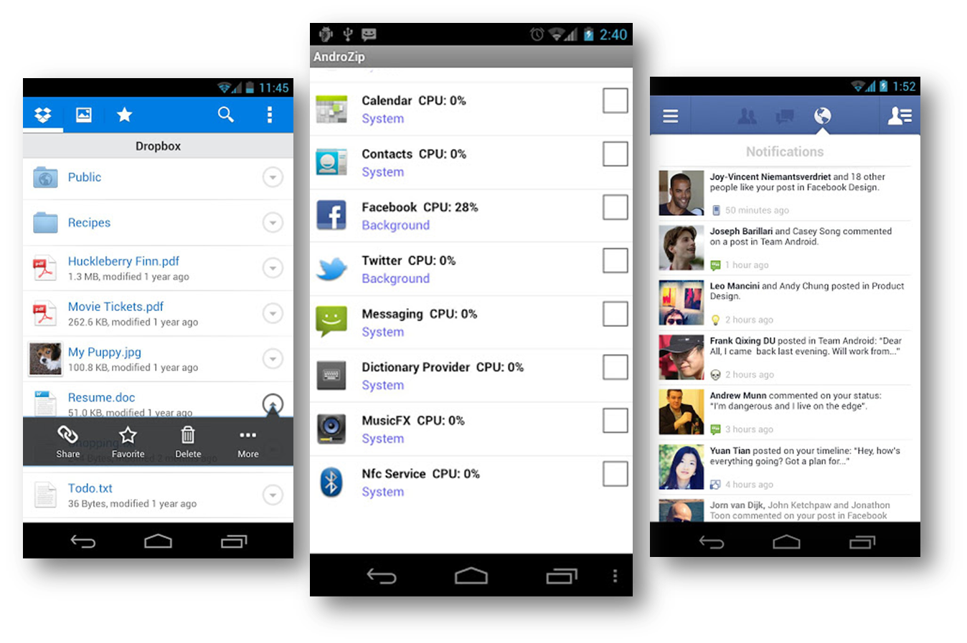
Displaying Data in Android
Donny Cordova | Assistant Professor Computer Systems Engineering Technology | Oregon Institute of Technology

Slide 2
Outline
Displaying Data
Image Assets
Data Adapters & Data Providers
ListFragments & DetailFragments

Slide 3
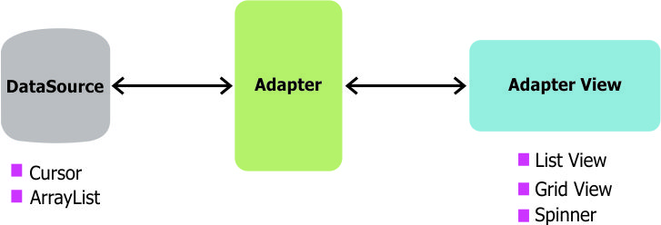
Displaying Data
In Android development, any time you want to show a vertical list of items you will want to use a ListView which is populated using an Adapter to a data source. When we want the data for the list to be sourced directly from a SQLite database query, we can use a CursorAdapter.
The CursorAdapter fits in between a Cursor (data source from SQLite query) and the ListView (visual representation) and configures two aspects:
Which layout template to inflate for an item
Which fields of the cursor to bind to which views in the template

Slide 4
Images
Use PNGS!
Create an Asset folder in project
Create Helper class/method to read PNG from file system and return a Bitmap

Slide 5
Data Provider and Data Adapter
Data Provider
Talk to Database to fetch Data
Contain ArrayLists and Map of Data
Can be a static block initially
Data Adapter
Extends ArrayAdapter<Type>
Inflates single item layout
Populates widgets with data and returns a View

Slide 6
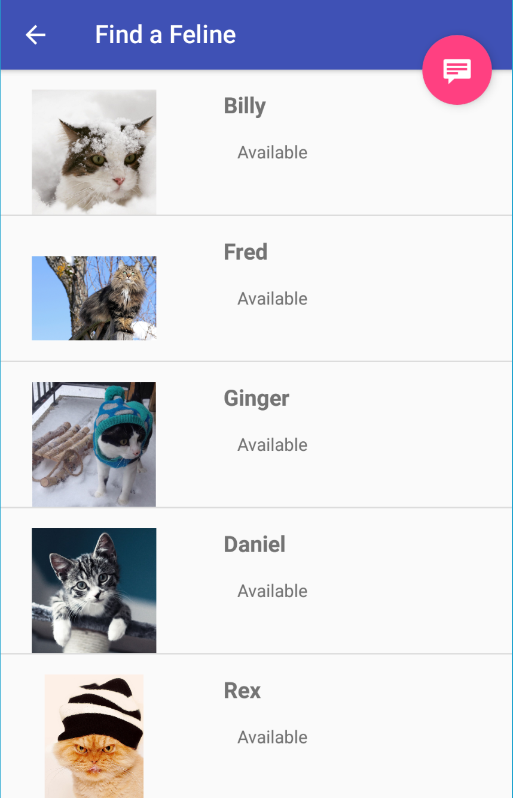
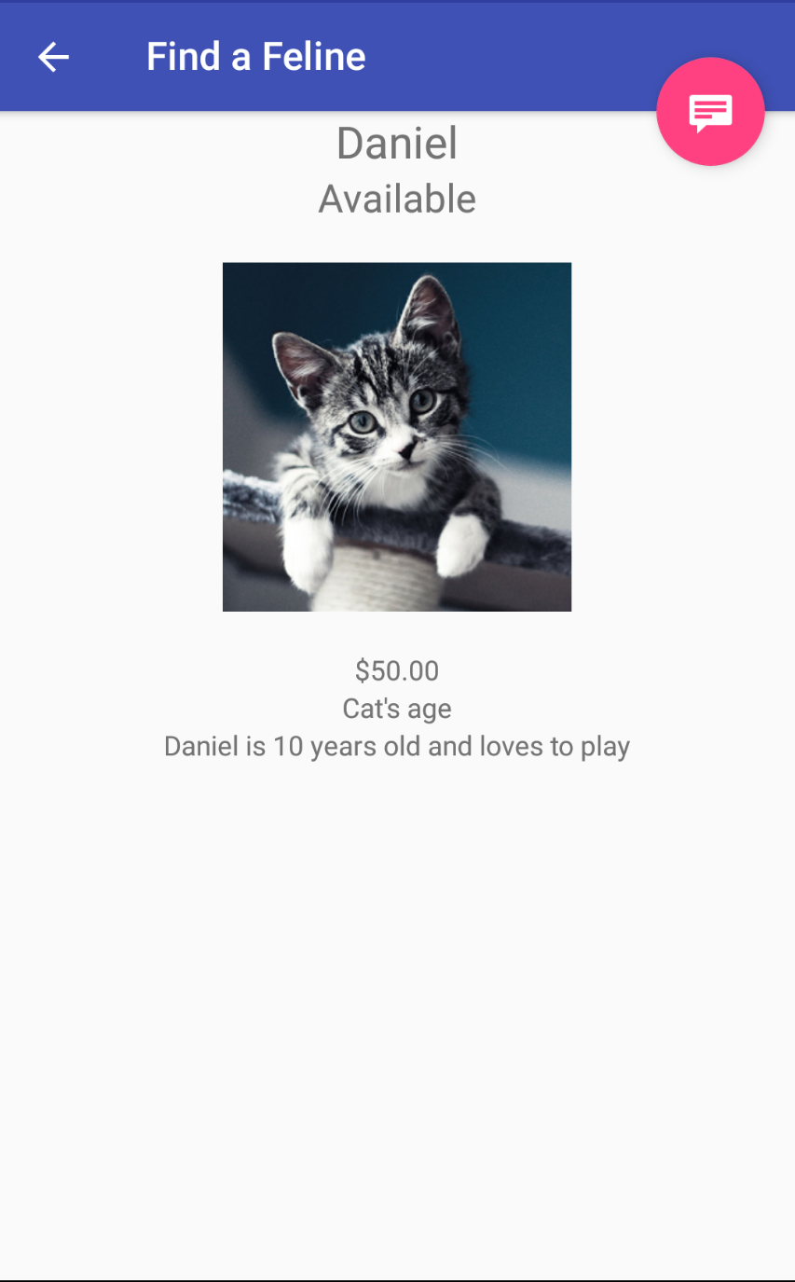
Data Drill Down from List to Detail View
ListFragment
onViewCreated()
Instantiate adapter and ties to a list of single item layouts
setAdapter to listView
Create OnItemClickListener
PutExtra to save the ID that was clicked
Drill down
DetailFragment
OnViewCreated()
GetExtra() to get item that was clicked
Get Refs to widgets and sets to data
Data Adapter
Data Provider

